Slide 1

COVID-19 IMPACT ON
CAR ACCIDENTS
IN THE USA
September 2020
by Celina Plaza

Slide 2
01
Background & Objective
02
Methodology
03
Findings
04
Key Takeaways

Slide 3


BACKGROUND
COVID-19’s Stay-At-Home orders.
Countless negative effects.
….but also glimmers of positive effects:
Less cars on road =
cleaner air
clearer views
more recreation

Slide 4
THE QUESTION
Did COVID-19’s
stay-at-home orders affect
car accident
frequency or severity?

Slide 5
METHODOLOGY
Data Collection
Cleaning & EDA
State Analysis
Modeling
3.5M US car accidents 2016-2020
+
Stay-At-Home dates by state
46 variables
Addressing outliers & null values
Bucketing categorical values
Examining distributions
Individual states’
car accident
frequency & severity shifts during
Stay-At-Home orders
Logistic Regression
Random Forest
XGBoost

Slide 6
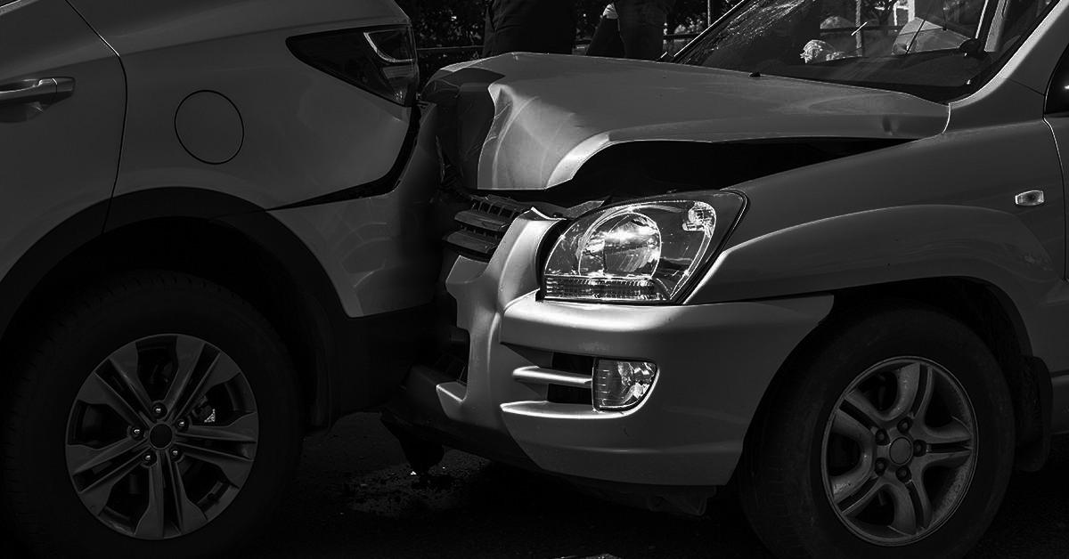
States’
Stay-Home Period Analysis

Slide 7
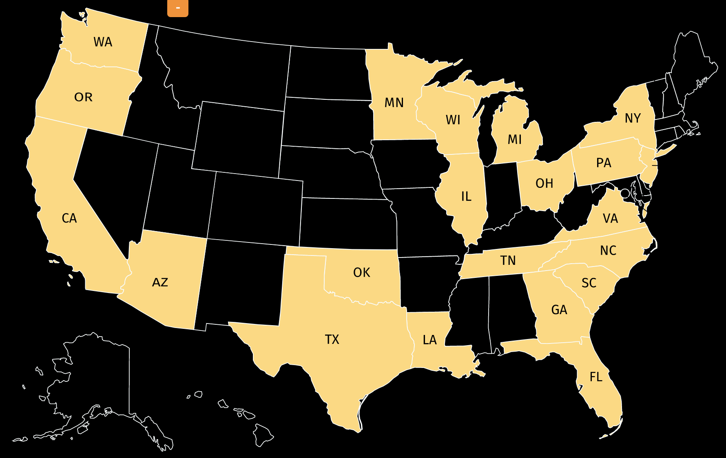
TOP 20 STATES WITH MOST CAR ACCIDENTS
86%
total US
car accidents
NJ

Slide 8
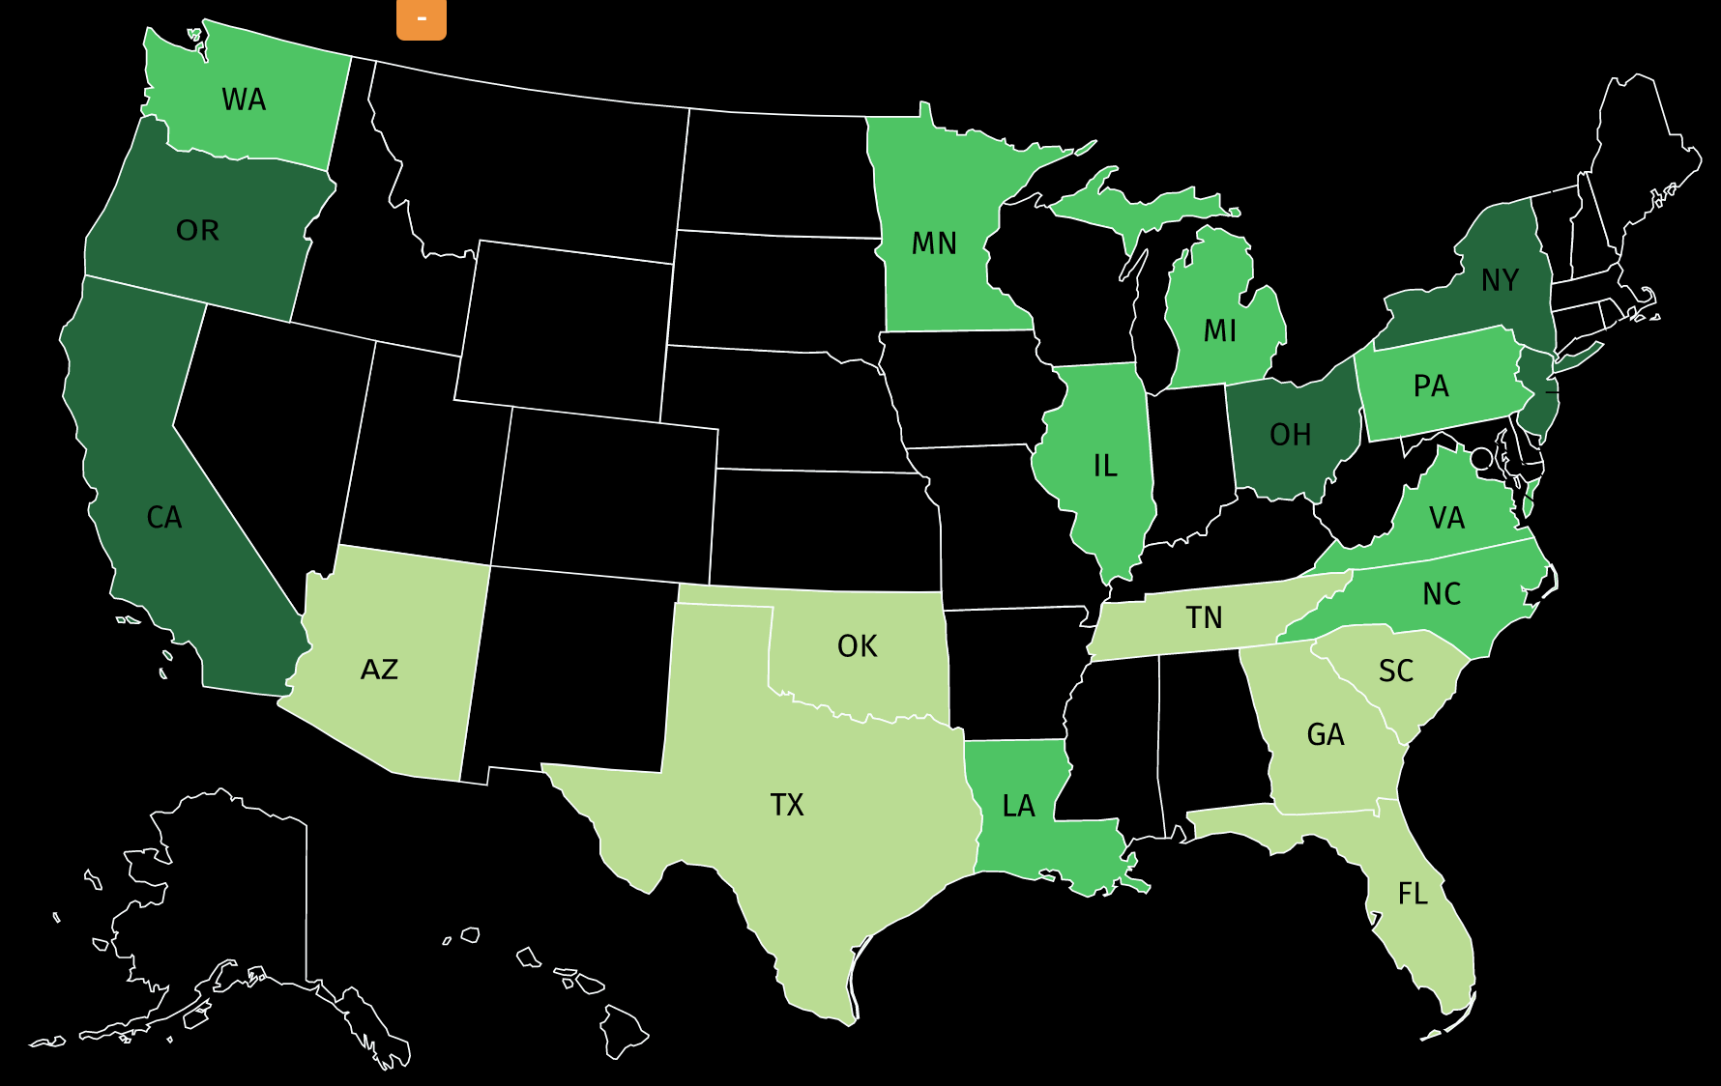
TIME UNDER STAY-AT-HOME ORDERS
NJ
81+ days
41 – 80 days
0 – 40 days

Slide 9
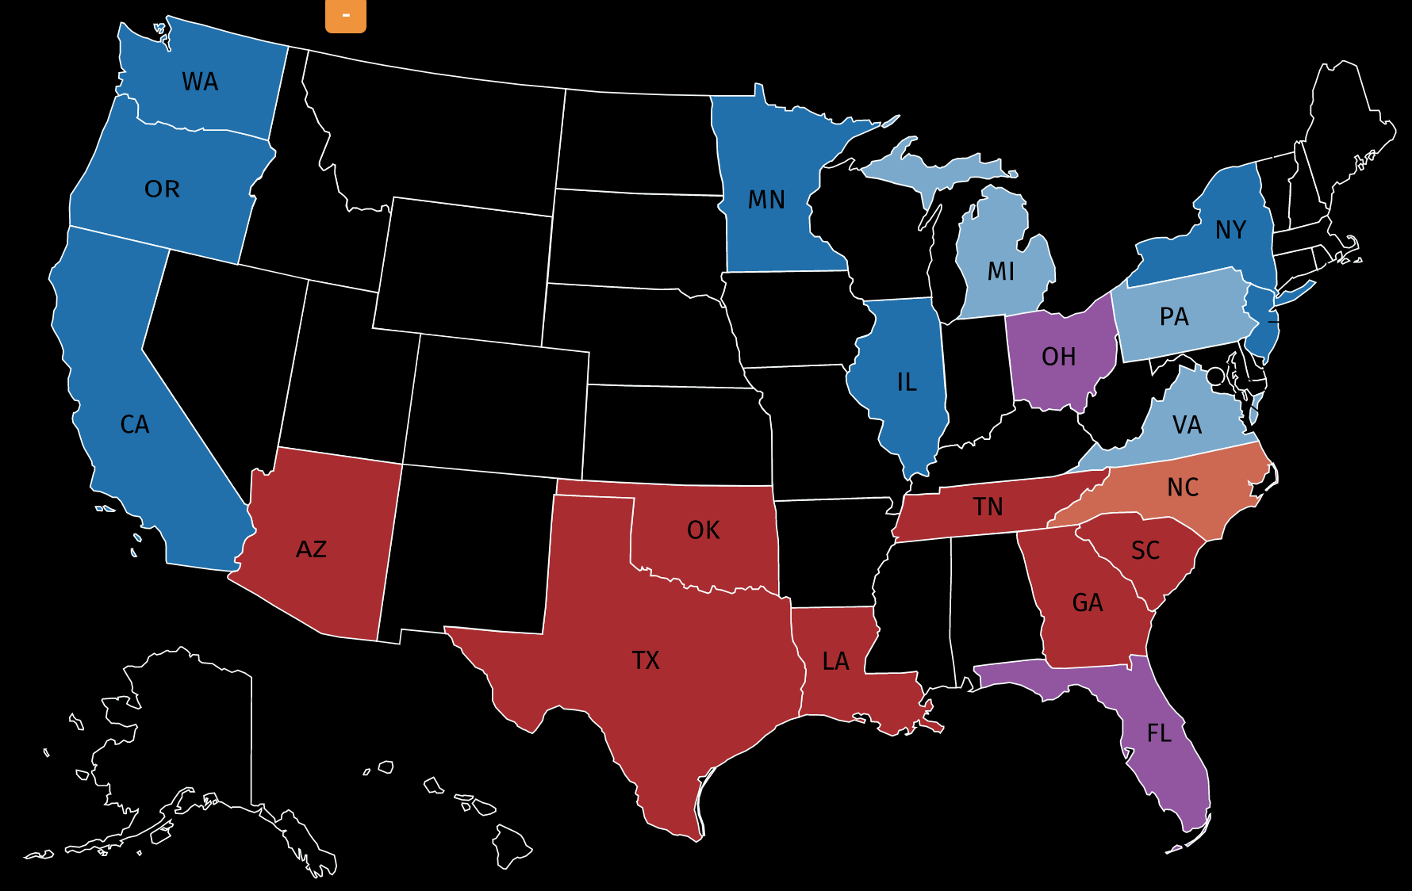
POLITICAL LEANING
NJ
Results of the 2004, 2008, 2012, and 2016 presidential elections:
States carried by the Democrats in all four elections
States carried by the Democrats in 3 of the 4 elections
States carried by each party twice in the four elections
States carried by the Republicans in three of the four elections
States carried by the Republicans in all four elections

Slide 10
Severity
Ranked as :
Low
Medium-Low
Medium-High
High

Slide 11
AVERAGE SEVERITY RANK FOR TOP 20 STATES* ACTUAL ‘STAY-HOME’ PERIOD 2020 COMPARED TO EQUIVALENT PERIOD YEARS PRIOR
Severity:
Percent of Total Car Accidents
Year
*States weighted by number of accidents to total

Slide 12
AVERAGE SEVERITY RANK FOR TOP 20 STATES* ACTUAL ‘STAY-HOME’ PERIOD 2020 COMPARED TO EQUIVALENT PERIOD YEARS PRIOR
Severity:
Percent of Total Car Accidents
Year
*States weighted by number of accidents to total

Slide 13
AVERAGE SEVERITY RANK FOR TOP 20 STATES* ACTUAL ‘STAY-HOME’ PERIOD 2020 COMPARED TO EQUIVALENT PERIOD YEARS PRIOR
8,870%
‘Low Severity’ increase in 2020 stay-home
period compared to average
2017 – 2019 equivalent periods
Severity:
Percent of Total Car Accidents
Year
*States weighted by number of accidents to total

Slide 14

CALIFORNIA
ILLINOIS
SEVERITY RANK BY STATE
Percent of Total Car Accidents
Percent of Total Car Accidents
Year
Year
Severity:

Slide 15
CALIFORNIA
ILLINOIS
SEVERITY RANK BY STATE
Percent of Total Car Accidents
Percent of Total Car Accidents
Year
Year
Severity:

Slide 16
CALIFORNIA
ILLINOIS
SEVERITY RANK BY STATE
Percent of Total Car Accidents
Percent of Total Car Accidents
Year
Year
Severity:

Slide 17
CALIFORNIA
ILLINOIS
SEVERITY RANK BY STATE
Percent of Total Car Accidents
Percent of Total Car Accidents
Year
Year
Severity:

Slide 18
Frequency

Slide 19
FREQUENCY OF CAR ACCIDENTS FOR TOP 20 STATES ACTUAL ‘STAY-HOME’ PERIOD 2020 COMPARED TO EQUIVALENT PERIOD YEARS PRIOR
Number Car Accidents
Year

Slide 20
FREQUENCY OF CAR ACCIDENTS FOR TOP 20 STATES ACTUAL ‘STAY-HOME’ PERIOD 2020 COMPARED TO EQUIVALENT PERIOD YEARS PRIOR
52%
increase in car accidents during
2020 stay-home period compared to average 2017 – 2019 equivalent periods
Number Car Accidents
Year

Slide 21
CALIFORNIA
TEXAS
FREQUENCY BY STATE
76%
Stay-Home 2020 period
vs. 2017-2019 average
37%
Stay-Home 2020 period
vs. 2017-2019 average

Slide 22

Level of Impact on
Car Accidents’ Severity

Slide 23
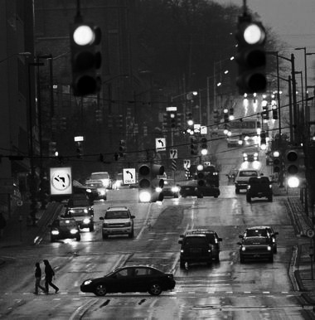
VARIABLES FOR PREDICTING SEVERITY RANK IN 2020
27 Variables Considered
Weather Conditions (Snow, Rain, Fog, Clear, etc.)
Day or Night
Temperature
Wind Speed
Signs (stop sign, traffic light)
Intersection w/Road (junction, railroad)
In period of stay-home orders

Slide 24
MODELS TESTED:
Logistic Regression
Random Forest
XGBoost

Slide 25
THE MODEL WITH INSIGHTS WE WANT :
Logistic Regression

Slide 26
THE MODEL WITH INSIGHTS WE WANT :
Logistic Regression
Why?

Slide 27
THE MODEL WITH INSIGHTS WE WANT :
Logistic Regression
Why?
71.6% Accuracy

Slide 28
THE MODEL WITH INSIGHTS WE WANT :
Logistic Regression
Why?
71.6% Accuracy
We’re interested in which direction the stay-at-home orders ‘pull’ the model
(i.e. coefficient positive or negative)

Slide 29
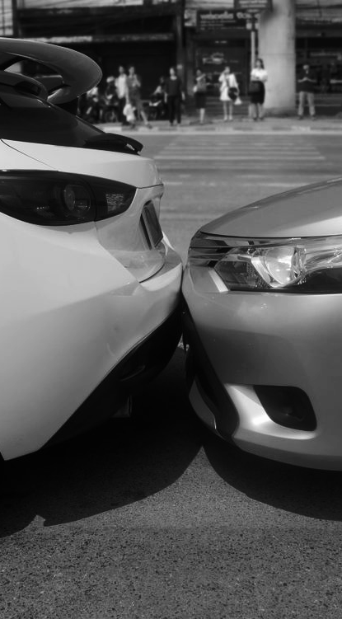
VARIABLES’ IMPACT ON SEVERITY OF CAR ACCIDENT
LESS SEVERE
WEATHER:
Clear/Fair
Foggy/Hazy
SIGNAL PRESENCE:
Traffic Light
INTERSECTION TYPE:
Crossing
SPECIAL:
Under ‘Stay-Home’ Orders

Slide 30
VARIABLES’ IMPACT ON SEVERITY OF CAR ACCIDENT
LESS SEVERE
WEATHER:
Clear/Fair
Foggy/Hazy
SIGNAL PRESENCE:
Traffic Light
INTERSECTION TYPE:
Crossing
SPECIAL:
Under ‘Stay-Home’ Orders

Slide 31
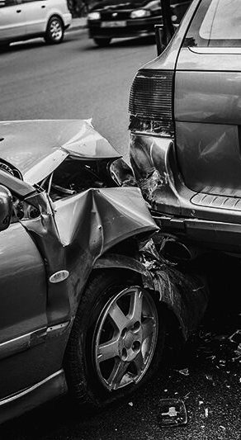
VARIABLES’ IMPACT ON SEVERITY OF CAR ACCIDENT
LESS SEVERE
MORE SEVERE
WEATHER:
Clear/Fair
Foggy/Hazy
SIGNAL PRESENCE:
Traffic Light
INTERSECTION TYPE:
Crossing
SPECIAL:
Under ‘Stay-Home’ Orders
WEATHER:
Rain/Thunderstorm
Snow/Hail
TIME OF DAY:
Nighttime
INTERSECTION TYPE:
Junction
TEMPERATURE:
Higher Temperature

Slide 32
SUMMARY OF FINDINGS
Did Stay-At-Home orders affect frequency or severity of car accidents?

Slide 33
SUMMARY OF FINDINGS
Did Stay-At-Home orders affect frequency or severity of car accidents?
Findings indicate:

Slide 34
SUMMARY OF FINDINGS
Did Stay-At-Home orders affect frequency or severity of car accidents?
Findings indicate:
Increase in frequency of accidents.

Slide 35
SUMMARY OF FINDINGS
Did Stay-At-Home orders affect frequency or severity of car accidents?
Findings indicate:
Increase in frequency of accidents.
Decrease in severity of accidents.

Slide 36
SUMMARY OF FINDINGS
Did Stay-At-Home orders affect frequency or severity of car accidents?
Findings indicate:
Increase in frequency of accidents.
Decrease in severity of accidents. Even when accounting for other ‘evergreen’ variables, such as weather and time of day.

Slide 37
SUMMARY OF FINDINGS
Did Stay-At-Home orders affect frequency or severity of car accidents?
Findings indicate:
Increase in frequency of accidents.
Decrease in severity of accidents. Even when accounting for other ‘evergreen’ variables, such as weather and time of day.
Individual states can vary significantly in degree shifts in frequency and severity.

Slide 38
SUMMARY OF FINDINGS
Did Stay-At-Home orders affect frequency or severity of car accidents?
Findings indicate:
Increase in frequency of accidents.
Decrease in severity of accidents. Even when accounting for other ‘evergreen’ variables, such as weather and time of day.
Individual states can vary significantly in degree shifts in frequency and severity.

Slide 39

THANK YOU Any Questions?
Celina Plaza celina.plaza@gmail.com
linkedin.com/in/celinaplaza celinaplaza.org
Full project:
github.com/cecann10/covid-impact-car-accidents

Slide 40
Appendix

Slide 41
FUTURE OPPORTUNITIES
Deepen investigation into potential reasons why there was an increase in number of accidents during stay-home period
Additional research to develop and test differences between states’ results
Further research on potential causes for increase in highest severity (level 4) for states during stay-home period
Analyze post-stay-home period to see how quickly (if at all) frequency and severity returned to average levels

Slide 42
VARIABLES’ IMPACT ON SEVERITY OF CAR ACCIDENT
LESS SEVERE
MORE SEVERE
WEATHER:
Clear/Fair
Foggy/Hazy
SIGNAL PRESENCE:
Traffic Light
INTERSECTION TYPE:
Crossing
SPECIAL:
Under ‘Stay-Home’ Orders
WEATHER:
Rain/Thunderstorm
Snow/Hail
TIME OF DAY:
Nighttime
INTERSECTION TYPE:
Junction
TEMPERATURE:
Higher Temperature

Slide 43
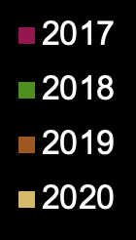
CALIFORNIA
TEXAS
FREQUENCY BY STATE
Year’s ‘Stay Home’ Period
Year’s ‘Stay-Home’ Period
Number of Accidents
Number of Accidents

Slide 44
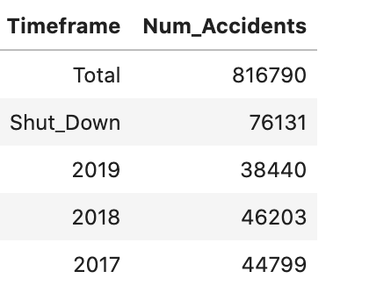
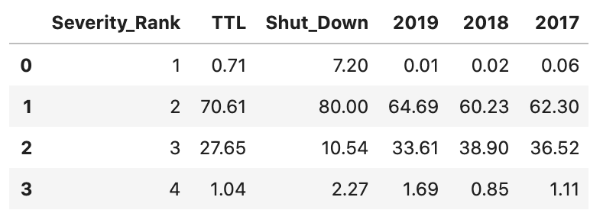
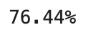
CALIFORNIA
Frequency
Severity
% Change 2020 vs. average 2017 - 2019:

Slide 45
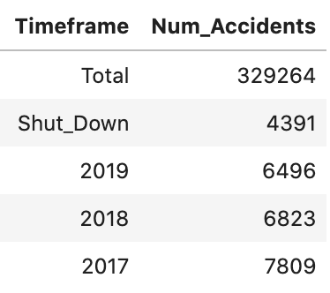
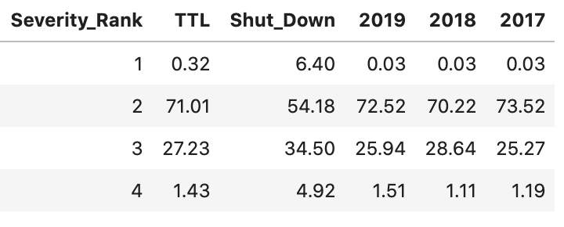
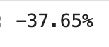
TEXAS
Frequency
Severity
% Change 2020 vs. average 2017 - 2019:

Slide 46
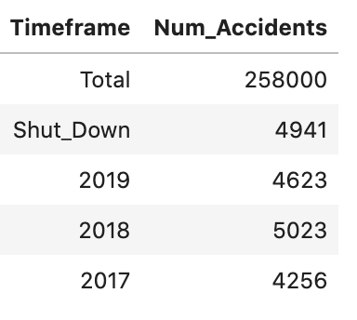
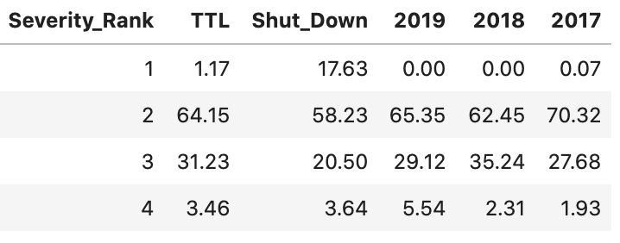
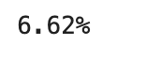
FLORIDA
Frequency
Severity
% Change 2020 vs. average 2017 - 2019:

Slide 47
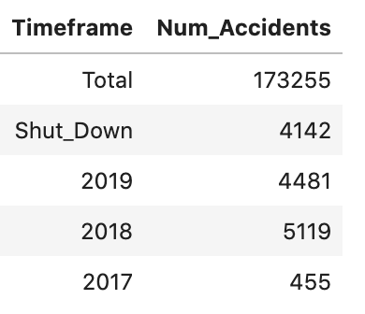
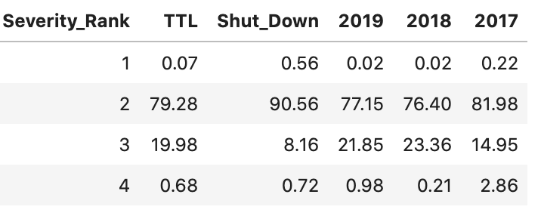
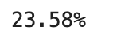
SOUTH CAROLINA
Frequency
Severity
% Change 2020 vs. average 2017 - 2019:

Slide 48
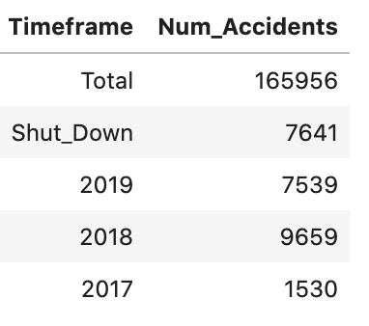
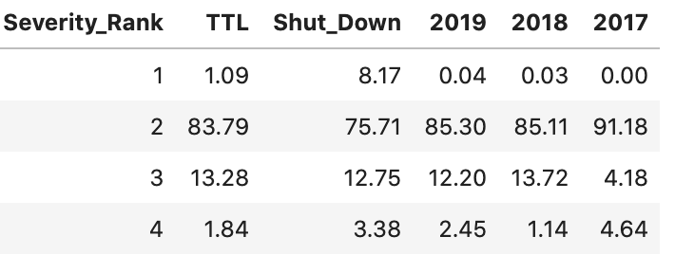
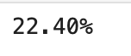
NORTH CAROLINA
Frequency
Severity
% Change 2020 vs. average 2017 - 2019:

Slide 49
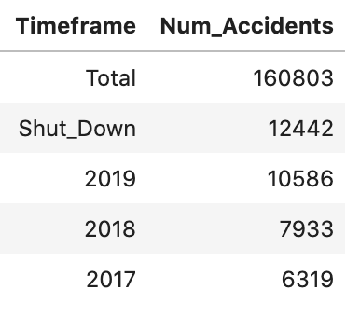
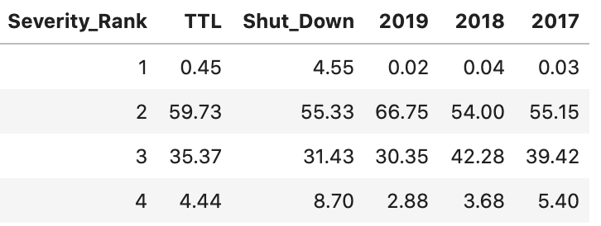
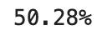
NEW YORK
Frequency
Severity
% Change 2020 vs. average 2017 - 2019:

Slide 50
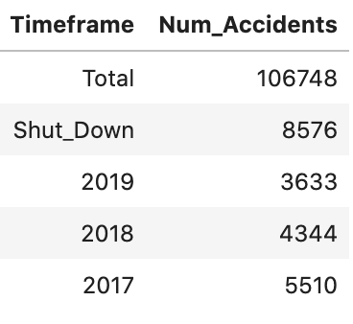
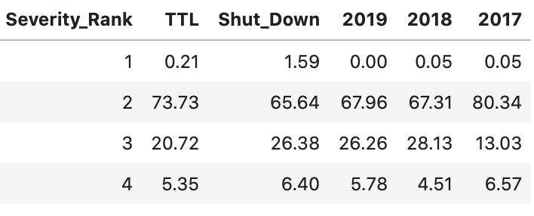
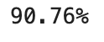
PENNSYLVANIA
Frequency
Severity
% Change 2020 vs. average 2017 - 2019:

Slide 51
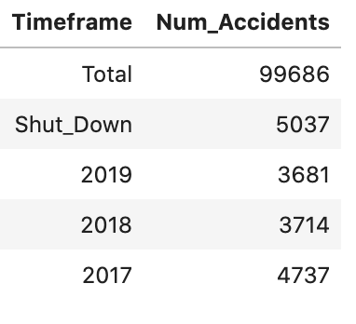

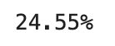
ILLINOIS
Frequency
Severity
% Change 2020 vs. average 2017 - 2019:

Slide 52
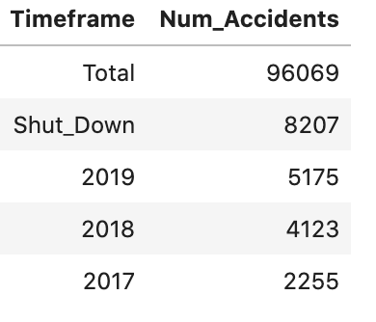
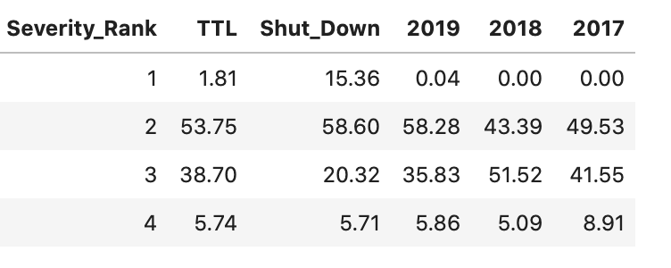
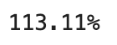
VIRGINIA
Frequency
Severity
% Change 2020 vs. average 2017 - 2019:

Slide 53
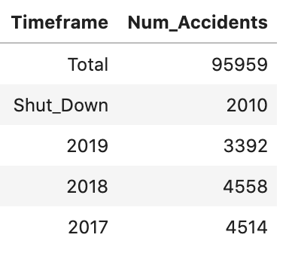
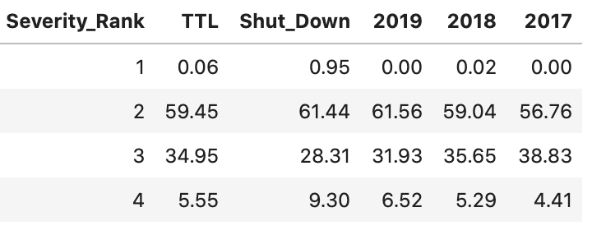
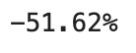
MICHIGAN
Frequency
Severity
% Change 2020 vs. average 2017 - 2019:

Slide 54
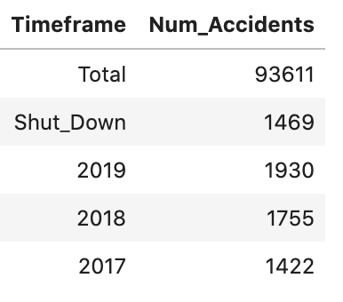
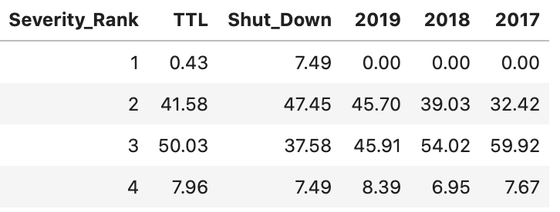
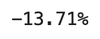
GEORGIA
Frequency
Severity
% Change 2020 vs. average 2017 - 2019:

Slide 55
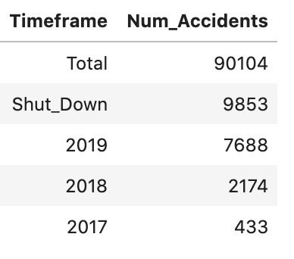
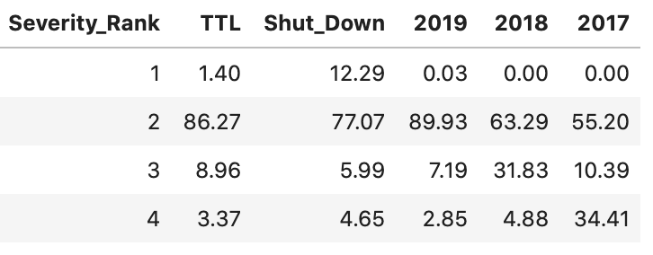
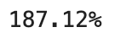
OREGON
Frequency
Severity
% Change 2020 vs. average 2017 - 2019:

Slide 56
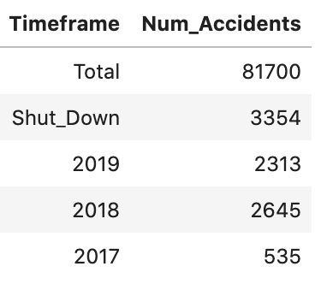
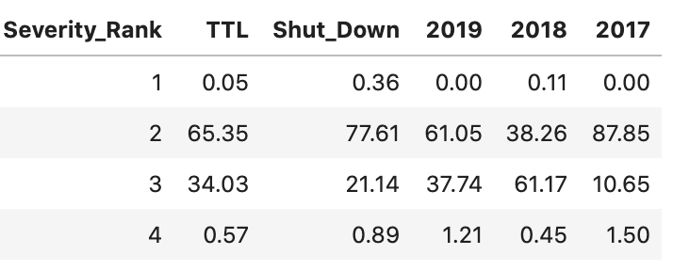
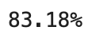
MINNESOTA
Frequency
Severity
% Change 2020 vs. average 2017 - 2019:

Slide 57
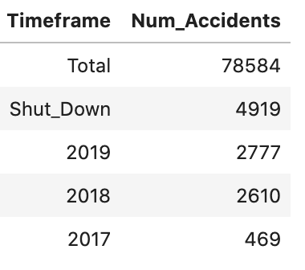
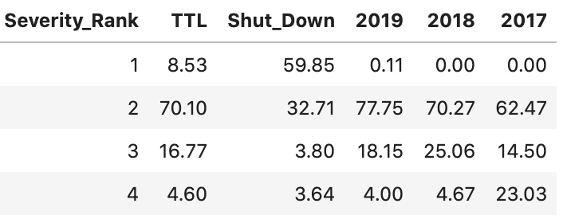
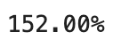
ARIZONA
Frequency
Severity
% Change 2020 vs. average 2017 - 2019:

Slide 58
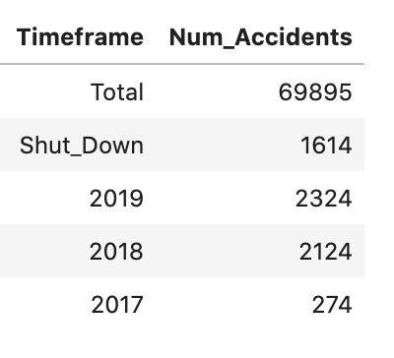


TENNESSEE
Frequency
Severity
% Change 2020 vs. average 2017 - 2019:

Slide 59



WASHINGTON
Frequency
Severity
% Change 2020 vs. average 2017 - 2019:

Slide 60



OHIO
Frequency
Severity
% Change 2020 vs. average 2017 - 2019:

Slide 61



LOUISIANA
Frequency
Severity
% Change 2020 vs. average 2017 - 2019:

Slide 62



OKLAHOMA
Frequency
Severity
% Change 2020 vs. average 2017 - 2019:

Slide 63



NEW JERSEY
Frequency
Severity
% Change 2020 vs. average 2017 - 2019:

Slide 64





SELECTED MODEL: LOGISTIC REGRESSION

